Slide 1

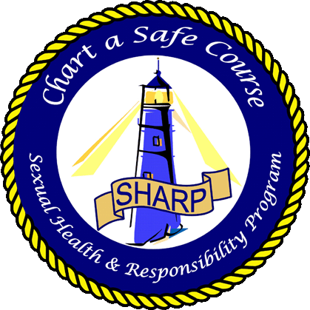
Reproductive and Sexual Health
HIV in the DoN
April 2019

Slide 2
Note to facilitator: consider showing your audience the NMCPHC film “HIV and Me” or “HIV Prevention” prior to using this PowerPoint slide set.
Get the films here:
  http://www.med.navy.mil/sites/nmcphc/health-promotion/reproductive-sexual-health/Pages/hiv-prevention-resources.aspx

Slide 3
Overview
Who is at Risk of Getting HIV?
How Is HIV Transmitted?
How Will HIV Affect My Life?
How Can I Avoid Getting HIV?

Slide 4
Human Immunodeficiency Virus (HIV) is the virus that causes
Acquired Immune Deficiency Syndrome (AIDS)
  No cure
  No vaccine
  1 million Americans are living with it
  200,000 don’t know they have it
  50,000 Americans are newly infected each year

Slide 5
Who is at Risk of Getting HIV?
Anyone exposed to the virus can become infected
Among men in the U.S. in 2014:
  9% got HIV from sex with a woman
  82% got HIV from sex with a man\
Men who have sex with men are much more likely to get HIV than are men who have sex with women because:
    anal sex is very risky
    as many as 1 in 5 men who have sex with men in the U.S. are living with HIV
Among women, 87% got HIV from sex with a man

Slide 6
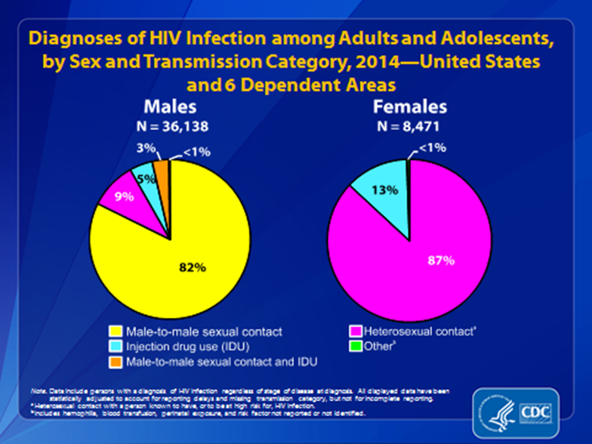

Slide 7
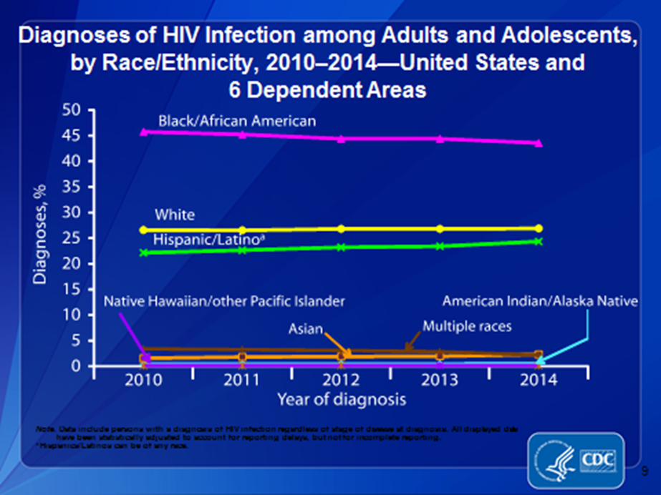
Who is at Risk of Getting HIV?
In the U.S., black men and women become infected with HIV at higher rates compared to white and Hispanic men and women, probably because their sexual partners are more likely to be infected.

Slide 8
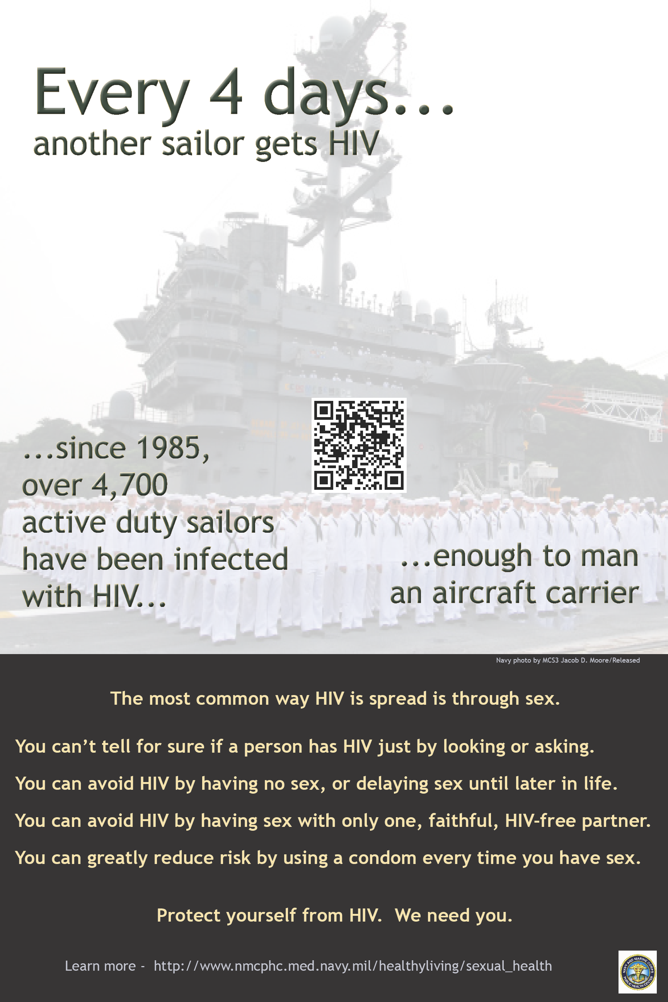
Who is at Risk of Getting HIV?
Since 1985, over 6,000 active duty Sailors & Marines have been infected with HIV
  65-100 newly infected each year
  Every 5 days, another is diagnosed with HIV
  500 HIV positive members are currently on active duty

Slide 9
Who is at Risk of Getting HIV?
Anyone who has sex with or shares needles with a person who has HIV can get HIV
Officer and Enlisted Sailors and Marines have become infected regardless of their gender, sexual orientation and ethnicity
In the U.S. in recent years, 1 of 5 people who was newly infected with HIV is a woman
  Active duty female Sailors and Marines get HIV, but this happens at lower rates than in the US population

Slide 10
Who is at Risk of Getting HIV?
Some people assume sex with a Sailor or Marine is “safe” because Sailors and Marines are tested regularly for HIV.
But this is a myth because although active duty members are tested every other year,
  Testing does not protect a person from getting HIV and …
  Sailors and Marines who get HIV may remain on active duty

Slide 12
How Is HIV Transmitted?
  Semen
  Vaginal fluid
  Rectal (anal) mucous
  Breast milk

Slide 13
How Is HIV Transmitted?
Modes of Transmission in U.S.
Most Common | Less Common
#1 = sex without condoms | Blood transfusions in the U.S.
Sharing needles | During birth or breast feeding

Slide 14
How Risky for HIV?
Receptive anal sex Highest Risk
Receptive vaginal sex
Insertive anal sex
Insertive vaginal sex
Receptive oral sex*
Insertive oral sex* Some Risk
* HIV transmission via oral sex is theoretically possible but rare, although many other infections may be transmitted that way.

Slide 15
How Is HIV Transmitted?
HIV is NOT transmitted through saliva, tears, hugs, handshakes or on the surfaces of inanimate objects like tools, telephones, toilet seats, etc.
HIV is NOT transmitted through food, water or insects

Slide 16
How Might HIV Affect My Life?
Health…
  On HIV medications daily for life.
“I don’t feel like doing anything. . .because I’m so fatigued from these meds that they give me.”
— HIV-positive Sailor

Slide 17
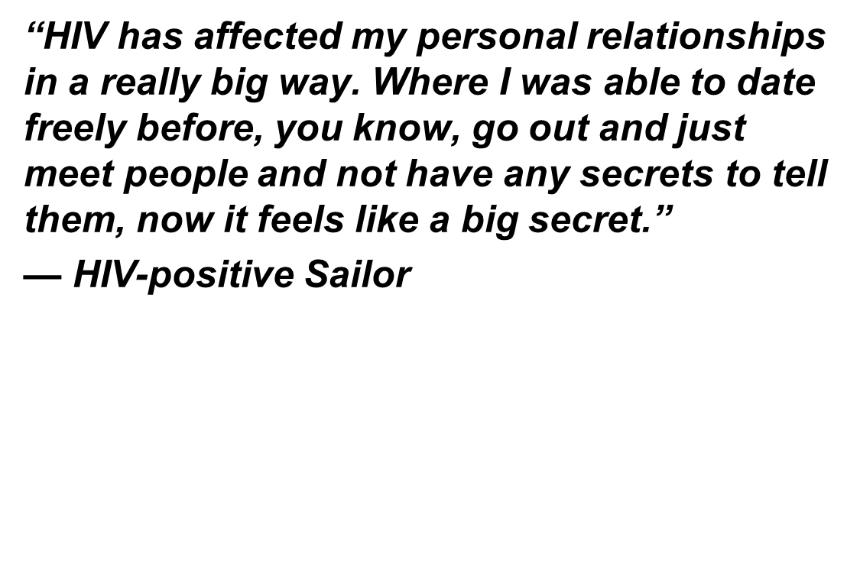
How Might HIV Affect My Life?
Relationships...
You must:
  Inform past and current sex partners about your HIV status so they may be tested
  Inform any potential new sex partner about your HIV status before intimacy
  Use a condom, abstain from sex or ensure your virus is controlled by medications
“I haven’t told my family yet because I just don’t want to worry them. My folks are old, and they don’t need to worry about this right now. I know that this would be very disappointing to them.” — HIV-positive Sailor

Slide 18
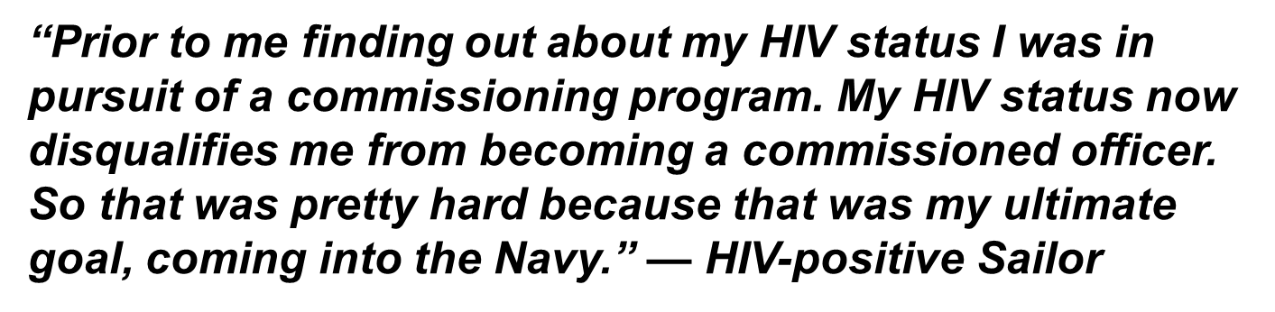
How Will HIV Affect My Life?
Career…
  Usually assigned only to non-deployable billet
  Usually only CONUS or Hawaii
  No commissioning opportunities

Slide 19
How Can I Avoid Getting HIV?
You can show affection without having sex
  Delay sex until another time in life
  Outer-course rather than Intercourse
    Outer-course is anything that is non-penetrative
    For example: hugging, kissing, massage, holding hands, love letters, phone calls
    Outer-course is much safer than intercourse

Slide 20
How Can I Avoid Getting HIV?
Long-term, mutual monogamy
  Some people have monogamous relationships with every person they date; but their relationships are short term
    These people may think they are “safe,” but they may not be
    Many short-term relationships involving sex without condoms, even if they are monogamous, means exposure to many people over time
  Don’t make the mistake that so many couples do and use a condom only the first time and then stop because “you’re a couple now.”

Slide 21
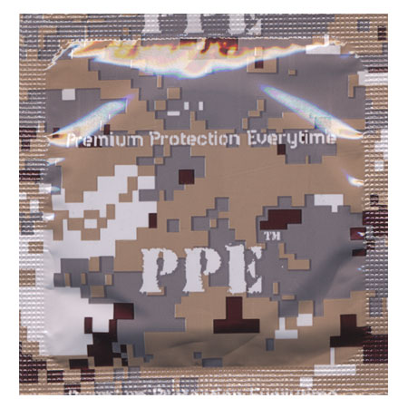
How Can I Reduce My Risk of Getting HIV?
Use condoms correctly and every time
  always have condoms readily available, and
  use a condom correctly every time you have sex.
Condoms require some advance planning.
Male or female, if you are sexually active, have condoms with you where and where you might need them

Slide 22
How Can I Reduce My Risk of Getting HIV?
Correct condom use means…
  Use a new condom for each act of vaginal, anal, or oral intercourse
  Put the condom on before penetration
  Unroll the condom by pinching the tip of the condom to create space at the tip
  Do NOT use oil-based lubes like Vaseline or baby oil with latex condoms
  After ejaculation, hold the condom firmly at the base of the penis and withdraw while erect

Slide 23
How Can I Reduce My Risk of Getting HIV?
In addition to using a condom, reduce risk by:
  Have sex with fewer people
  Take HIV medicine each day (PrEP)
  Ask for HIV medicine after an exposure (PEP)
  Avoiding high-risk partners
    people who accept
    money for sex
    People who may have
    had multiple partners
  Avoid highest risk sex acts
    Riskiest is unprotected receptive anal sex

Slide 24
About PEP
HIV Post-exposure prophylaxis (PEP)
Pills taken each day for 28 days after an exposure
Must be started with 72 hours of the exposure
For people at substantial risk for HIV
Can decrease HIV risk by 85%
Ask your doctor

Slide 25
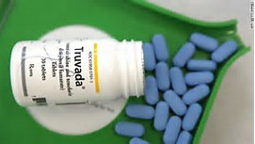
About PrEP
HIV Pre-exposure prophylaxis (PrEP)
One pill taken each day (Truvada)
For people at substantial risk for HIV
Can decrease HIV risk by 90%
Can use until HIV risk/circumstances change
Ask your doctor

Slide 26
Review of Risk Reduction Options
You can eliminate HIV risk:
  Delay sex until another time in your life
  Have outer-course rather than intercourse
  Practice monogamy with an uninfected partner / be faithful
You can reduce HIV risk:
  Use a condom every time
  Have sex with fewer people
  Don’t trade money for sex
  Avoid sex with people who may have had many other sex partners
  Avoid high risk sex acts
  Use PrEP / PEP
Stay sober and in control

Slide 27
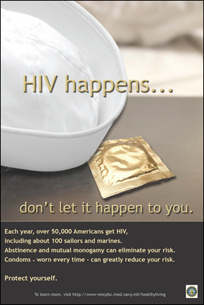
Summary
Who is at Risk of Getting HIV?
How Is HIV Transmitted?
How Will HIV Affect My Life?
How Can I Avoid Getting HIV?

Slide 28
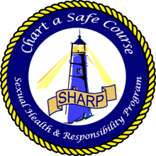
Thank you for helping our people to
‘chart a safe course’
Navy and Marine Corps Public Health Center
Sexual Health and Responsibility Program (SHARP)
620 John Paul Jones Circle, Suite 1100
Portsmouth VA 23708
web:
http://www.med.navy.mil/sites/nmcphc/health-promotion/reproductive-sexual-health/Pages/reproductive-and-sexual-health.aspx
(757) 953-0974 [DSN 377]

